Slide 1
Data Visualization - Analysis and Reporting

Slide 2
Business Intelligence
BI(Business Intelligence) is a set of processes, architectures, and technologies that convert raw data into meaningful information that drives profitable business actions.

Slide 3
Why is BI important
Measurement: creating KPI(Key Performance Indicators) based on historic data
Identify and set benchmarks for varied processes
With BI systems organizations can identify market trends and spot business problems that need to be addressed
BI helps on data visualization that enhances the data quality and there by the quality of decision making.
BI systems can be used not just by enterprises but SME(small and Medium Enterprises).

Slide 4
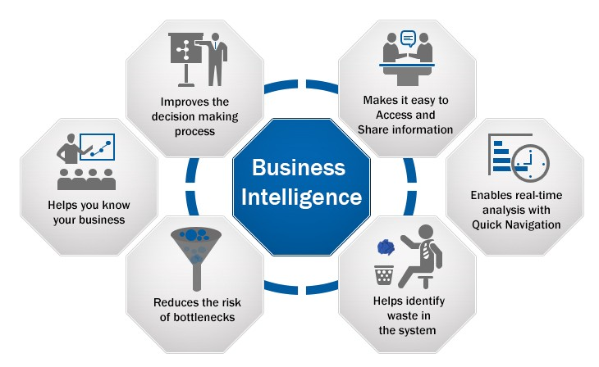

Slide 5
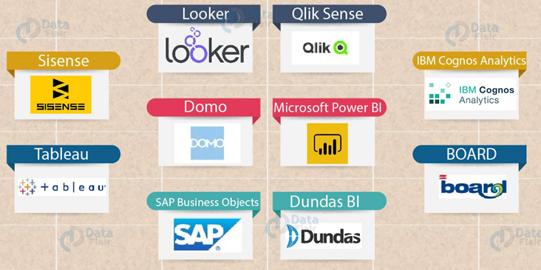
BI Tools

Slide 6
Managing BI
BI Management refers to the process of data management. It generally is composed of four components analysts ,data solutions ,decision making and oversight. BI software generates the actual data and then BI management interprets the data using tools in the BI systems. The raw data is analyzed and converted into performance metrics that business users rely on to make decisions

Slide 7
BI user segmentation
Segmentation is needed to drive higher profitability through understanding customer needs and delivering on those needs.
Case study on profitable customer

Slide 8
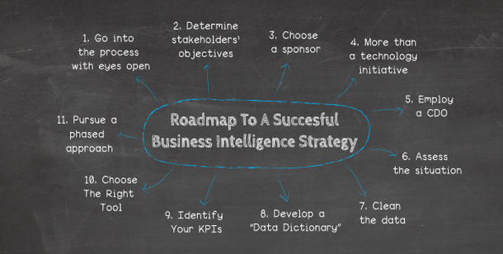
BI Strategy

Slide 9
Advantages of Business Intelligence
Boost Productivity
Improve Visibility
Fix Accountability
It gives bird’s eye view
It streamlines Business Process
It allows for easy analytics

